Slide 2
3D blade model updating by coupling HAWC2 and ABAQUS
Maria Luz Castilla Mena (s212601@dtu.dk)
Notes:
Hi, I am Maria and I am going to present my master thesis topic: Evolution of blade cracks with wind turbine simulation tolos (this is a provisional titile, it needs to be discussed)

Slide 3
INDEX
From last meeting
Progress of the project
For the next meeting

Slide 4
From last meeting
Main objective: Create a practical wind case to demonstrate the MATLAB interface
Goal: Generate 3D turbulence with a 1D profile
I currently have real data for the “u” wind direction in Tarifa (600sec simulation)
I need to generate “v” and “w” wind direction data from the 1D profile I have
How: hipersim Python library
Generate .bin turbulence files in the “u”, “v” and “w” direction to generate the wind profile in HAWC2

Slide 5
Progress of the project

Slide 6


Progress of the project
Python code
Get .bin turbulence files for the 3 directions
Run HAWC2
Turbulence box coordinates
How to output the whole result (Jupyter Notebook truncates the results)
Modified outline of the Master Thesis for paper
Cover page received

Slide 7
Results

Slide 8
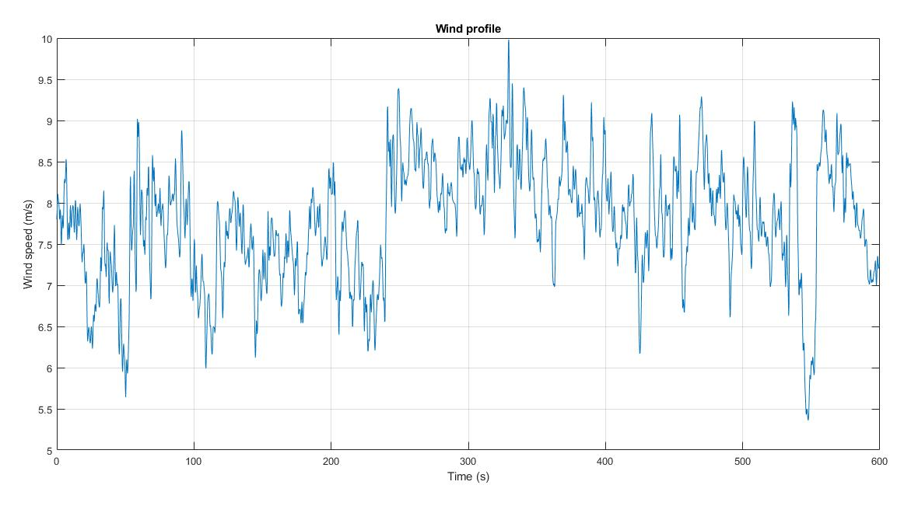
Wind profile
1240_040.dat file
Turbulence intensity = 0.0925 --- no wind gusts

Slide 9
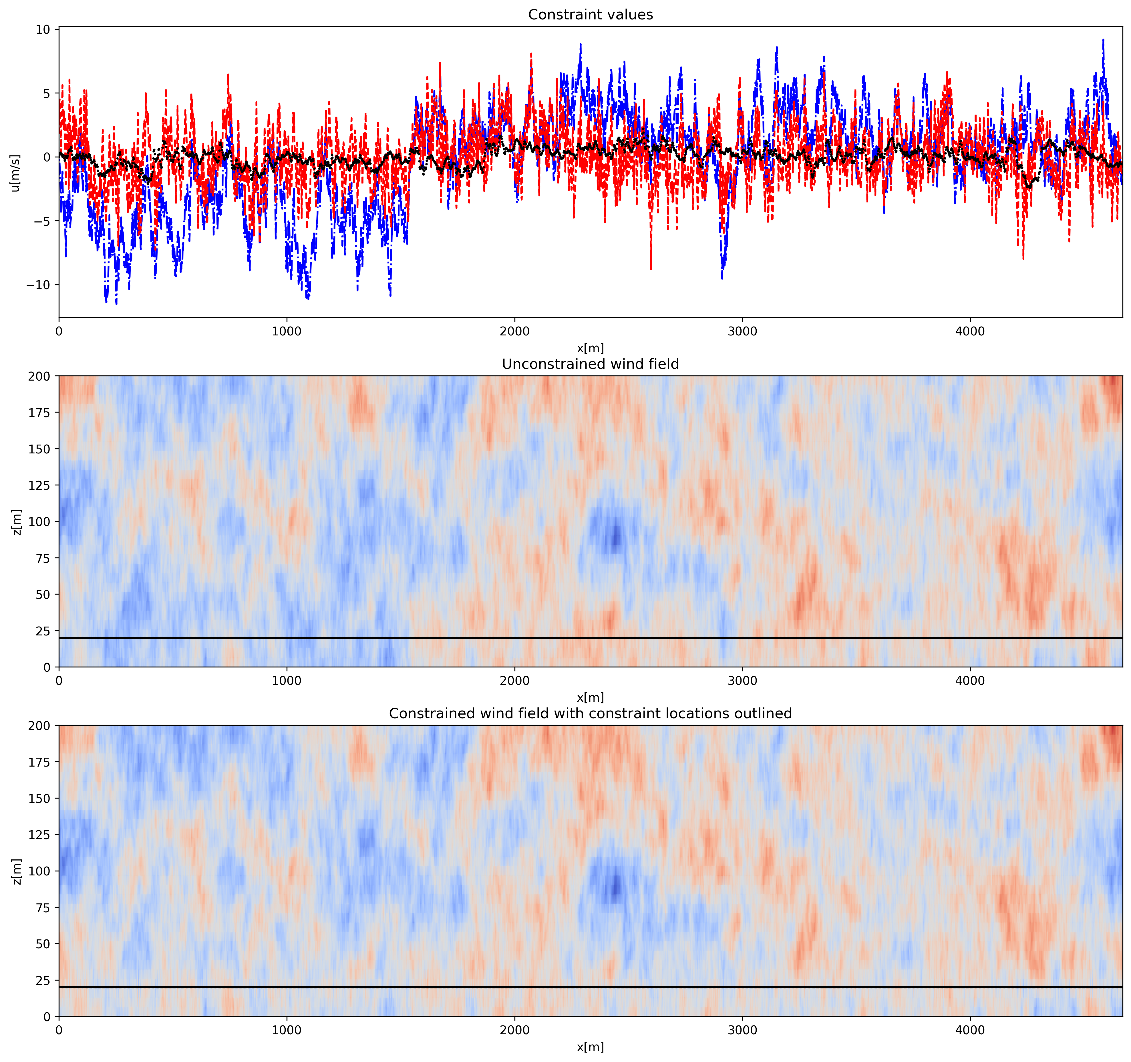
Wind profile
Blue line: u without constraints
Red line: u with constraints
Black line: wind information from .dat file

Slide 10
Wind profile

Slide 11
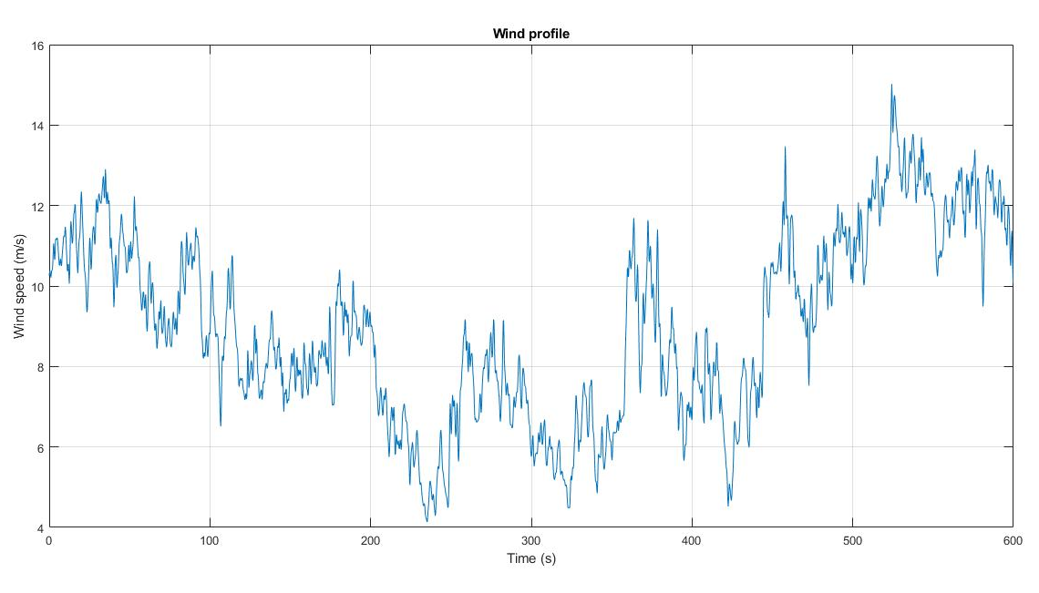
Wind profile
0754_040.dat file
Turbulence intensity = 0.256 --- wind gusts
Mean wsp = 9 m/s

Slide 12
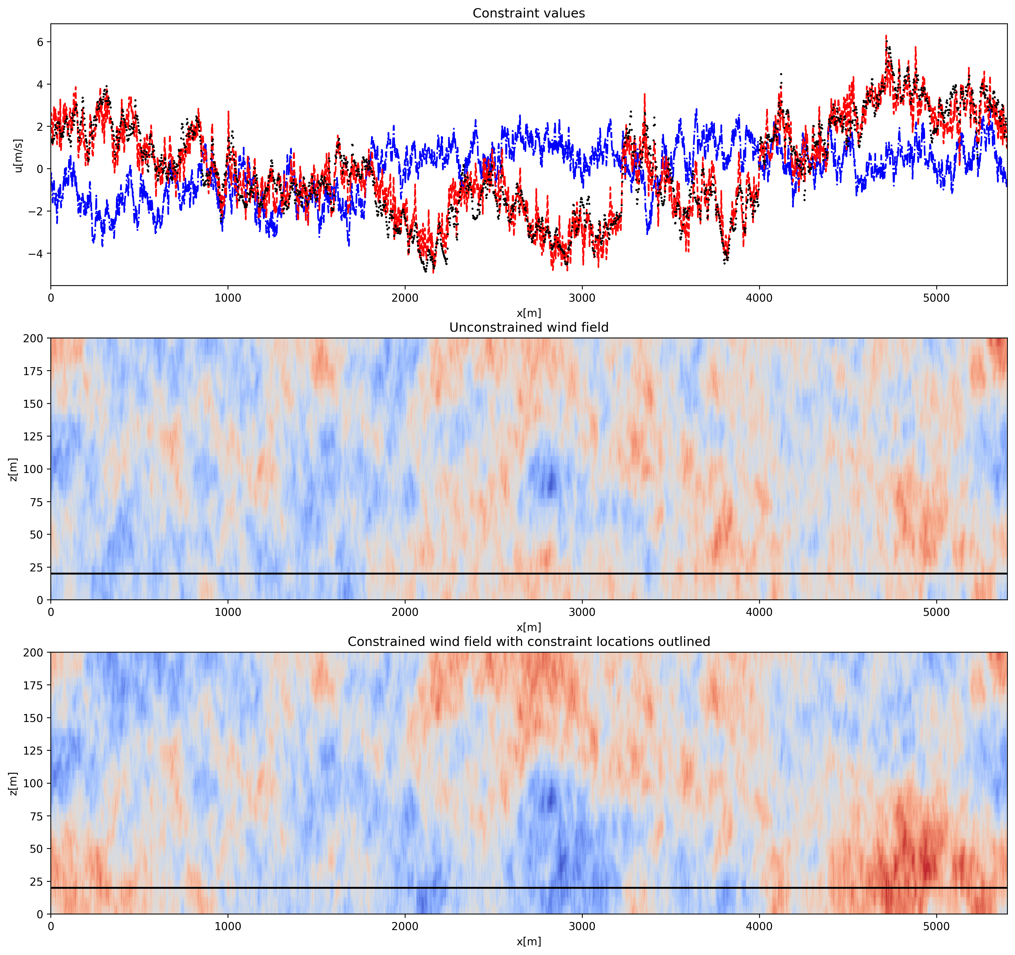
Wind profile
Blue line: u without constraints
Red line: u with constraints
Black line: wind information from .dat file

Slide 13
Wind profile

Slide 14
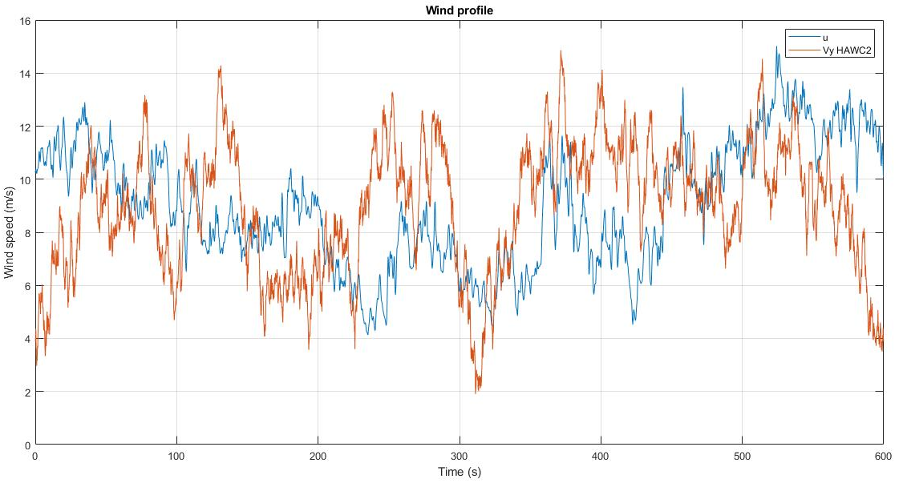
Mean wsp u = 8.99 m/s
Mean wsp Vy HAWC2 = 8.94 m/s

Slide 15
Outline paper
Modified version after the meeting
Introduction: The upcoming of a storm and the importance to react accordingly
1.1. Storms: Why they should be analyzed in a wind turbine context
1.2. General procedure of wind turbines during a storm
1.3. Objective and significance
1.4. Introduction: Simulation using HAWC2 and ABAQUS. Why linking these programs?
MATLAB interface to predict wind turbine blade behaviour during a storm
2.1. Workflow of the simulation
Case study: Real example of a storm simulation and results using the MATLAB interface
Conclusion: added value to the research community (answer to introduction).

Slide 16
For next meeting…

Slide 17
For the next meeting
Turbulence box: coordinates
Automate process
Wind coordinates vs. General coordinates
Coordinates in Python code?
Suggestions?

Slide 18
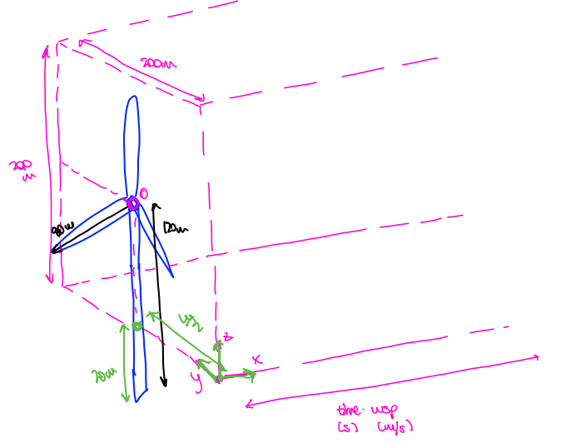

Slide 19
For the next meeting
Turbulence box: coordinates
Automate process
Wind coordinates vs. General coordinates
Coordinates in Python code?
Wind profile .dat files: measure u component?
Suggestions?

